Slide 1


CYS403 Project deliverable
Payment Gateway - MADA Pay Alrajhi Bank
Instructor: Dr. Abeer Mirdad
Section: 1267
Students:
Sarah Aljurbua 220410528
Noura Alsaud 220410204

Slide 2
Table of Contents
Introduction
State-of-the-Art
Monitoring
Threat and Risk Assessment
Conclusion
Executive Summary + References
Risk Mitigation

Slide 3
Introduction
Why Alrajhi Bank?
Why MADA Pay?
What is MADA Pay?
MADA Pay competitors
How does MADA work?

Slide 4
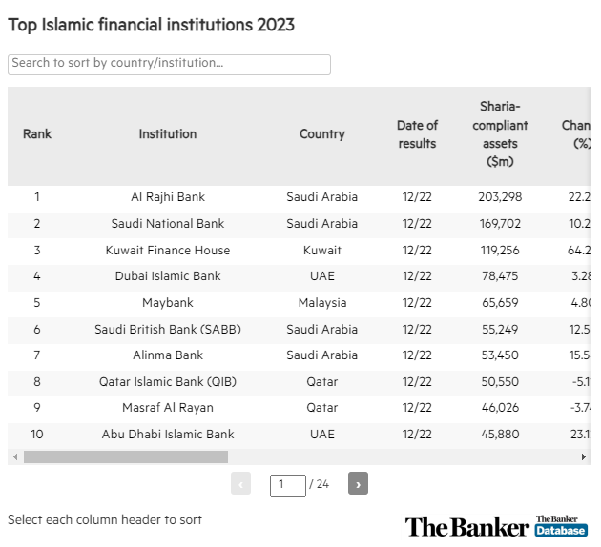
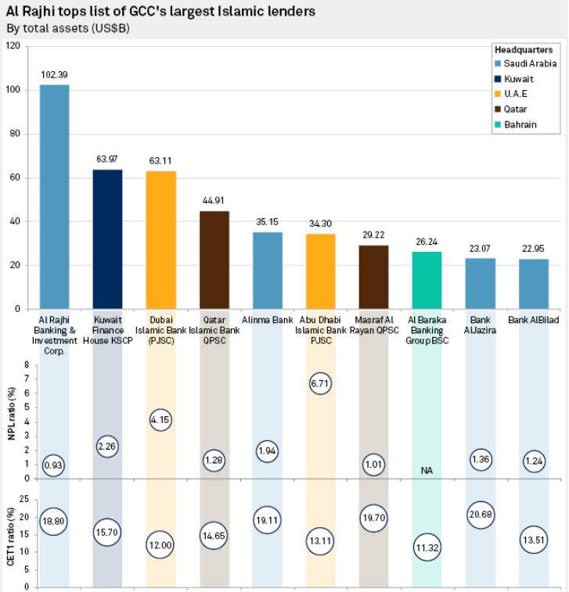
Appendix

Slide 5
1.1. State-of-the-Art MADA Pay
1
Alrajhi Bank’s infrastructure is built on robust frameworks that encompass digital encryption, biometric authentication such as face ID recognition, and real-time fraud detection systems which ensure the safeguarding of customers, their transactions, and their data across all of their various banking channels.
2
MADA Pay addressed those concerns through advanced - more cyber oriented - security features such as tokenization, E2EE (End-to-End Encryption), 2FA (2 Factor Authentication), SE (Secure Elements), and lastly Dynamic CVV.
3
Comprehensive risk assessments were introduced specifically made for MADA Pay as it conducts thorough risk assessments to identify potential security threats which involves analyzing the payment system’s vulnerabilities to various types of attacks and cyber frauds such as phishing, malware, and unauthorized accesses.

Slide 6
2.Threat and Risk Assessment
2.1. Listing, Qualifying, and Quantifying Threats
CVE-201-4197
Covid’s pandemic strike
CVE-2014-419
political, natural, operational, competitive, and reputational threats (Gaza war attack)

Slide 7
2.2. Understanding Causes of Threats
CVE-201-4197 | Exploited system vulnerabilities in the SQL anti-injection defender
CVE-2014-419 | Poor placed security implementation
Covid’s pandemic strike | Lack of basic system detections and the attacker's ability to exploit the system’s vulnerabilities that were mistakenly placed online
Political Threat | Human error-caused threats and exploits, hatred filled motivation

Slide 8
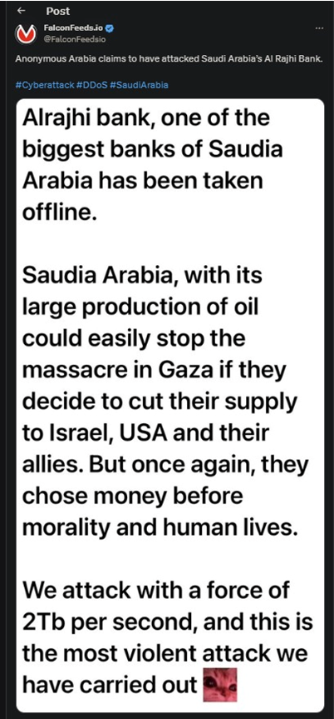

Appendix Who is Anonymous Arabia?

Slide 9
2.3. Vulnerabilities, Weaknesses, and Strengths
*Disclaimer: most data regarding vulnerabilities and weaknesses of Alrajhi Bank's MADA Pay are proprietary and require internal assessment.
Vulnerabilities
Weaknesses
Strengths

Slide 10
2.4. Analysis of Current Security Situation
Analyzing Alrajhi Bank’s (MADA Pay) current security situation data was taken from Alrajhi’s AR 2023 (in references), appears to be stable from a financial perspective, with “Fitch Ratings affirming the bank's Long-Term Issuer Default Rating at 'A-' with a Stable Outlook​” (Fitch, 2023) (refer to Fitch Ratings)​. This suggests that the bank maintains a strong position in terms of financial stability and creditworthiness.
In response to cyber threats and to ensure the safety of its operations, Al Rajhi Bank has ongoing security measures in place to protect its digital infrastructure and customer data safety. These measures are critical in safeguarding against the evolving landscape of cyber threats.

Slide 11
2.5. National Policies, Compliances and Guidelines
Al Rajhi Bank adheres to several national security standards and guidelines to ensure the security of its customers:
Corporate Governance Guidelines: Al Rajhi Bank must comply with corporate governance guidelines set by SAMA.
Information Security Standards: Al Rajhi Bank must comply with information security standards set by SAMA.
Saudi Arabian Monetary Authority (SAMA): SAMA is the central bank of Saudi Arabia and regulates banks and financial institutions in the country.
Anti-Money Laundering (AML) and Counter-Terrorist Financing (CTF)
Sharia Compliance: As an Islamic bank, Al Rajhi Bank must comply with Sharia principles.
Data Protection Regulations include encryption, secure communication paths, and data privacy.

Slide 12
2.6. Asset Inventory
1- Physical Assets: POS terminals, card readers, cash registers, and ATMs.
2- Intangible Assets: MADA Pay mobile application, payment gateway software, online banking platform, customer transaction data, payment processing data, user authentication data, encryption keys, brand trademarks, software patents, and proprietary algorithms.
3- Financial Assets: Revenue from Mada Pay transactions, cash and national gold reserves, and investments such as stocks and holdings.

Slide 13
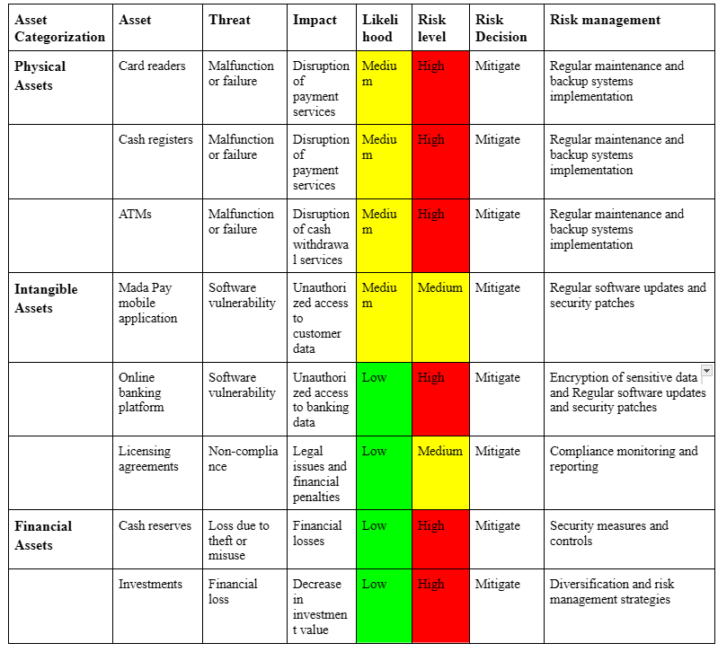
2.7. Risk Register

Slide 14
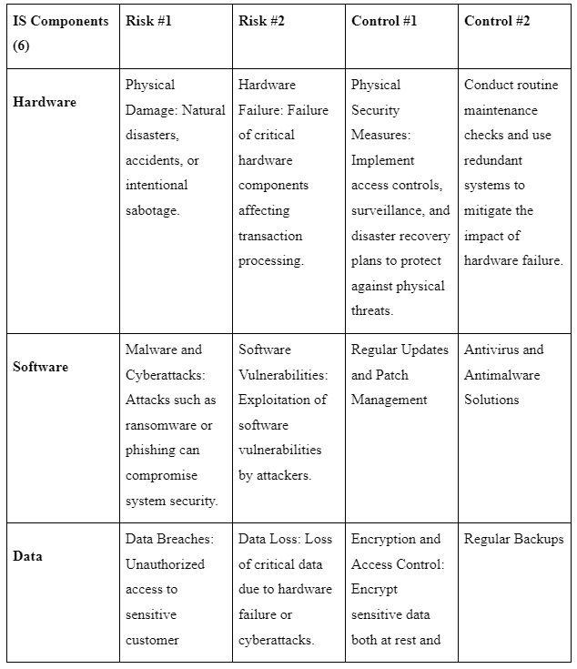
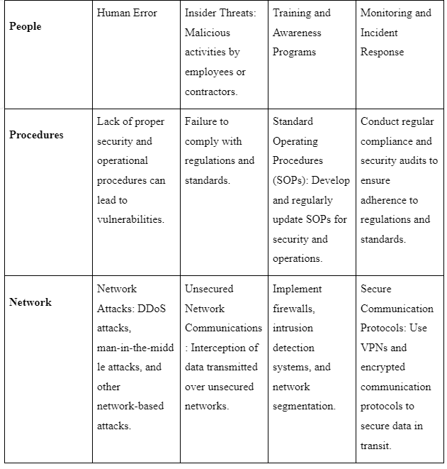
2.8. Risk Management Plan (IS Components)

Slide 15
3. Risk Mitigation
Security Operations
Cyber Security Enhancements
3.1 Development of Mitigation Measures
Advanced Persistent Threat (APT) protection system: detects more unnoticed complications
Encrypt using the Secure Socket Layer (SSL)/ Transport Layer Security (TLS): protects both data in MADA Pay and data traveling to other systems
Tokenization on all the payment details coming from the client by changing the data into unique id symbol which protects integrity
notify SOC about security and manage the incident response
Perform red team attacks to challenge the system strength and discover security vulnerabilities
Authentication and Access Control
Data Protection and Privacy
Biometric authentication between customers and employees on secure systems
Notifies works about PoLP (principle of least privilege)
End-to-End encryption for any data stored and transmitted
Data masking for (PII) that are used in insecure environments

Slide 16
3. Risk Mitigation cont.
3.2 Assessment of Residual Risk:
Quantitative risk assessment:
Calculating possible financial outcomes of the mitigated risk
Adjust the mitigation options based on the outcomes
Qualitative risk assessment:
using expert reviews on the leftover risks and use the responses to adjust the process
3.3 Making Risk Decisions:
Establish the risk register which will identify all the risks, the purpose of mitigation, and those responsible for risk management
Write escalation protocols to guarantee the risk with the impact or likelihood will be escalated quickly to senior management's attention for decisions-making
3.4 Implementation of Mitigation Measures:
Develop and provide continuous training on cybersecurity by using phishing simulation s and security newsletters
Develop Incident Response Plan (IRP) with details of: who does what, means of communications, stages of recovery

Slide 17
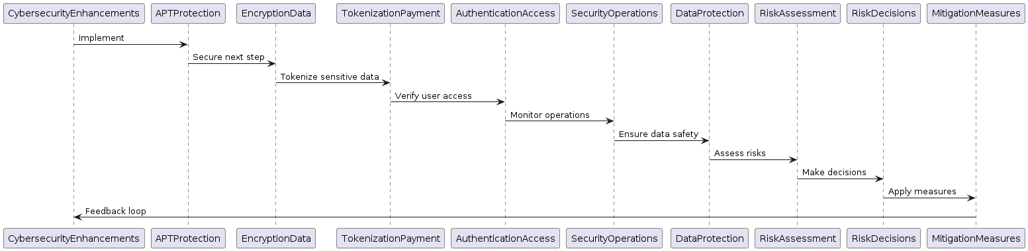
Appendix

Slide 18
4. Monitoring
4.1 Enhanced Security Approach
Continuous and Real-Time Monitoring Install NIDS and HIDS across MADA Pay infrastructure for live monitoring of intrusions Security Information and Event Management (SIEM) too to monitor the system for weaknesses
Threat Intelligence and Vulnerability Management Subscribe to leading sources of threat intelligence to improve detecting threats Deploy vulnerability management tools such as Qualys and Tenable Nessus which will support periodical scanning and assessment of IT infrastructure
4.2 Improvement of CIA Triad
Availability: provide backup and recovery solution that is held in on-premises cloud store Confidentiality: restoring data after the crisis take place by implementing drills to detect bugs quarterly

Slide 19
6.2. References
The Banker’s Top Islamic Financial Institutions 2023. (n.d.). Www.thebanker.com https://www.thebanker.com/The-Banker-s-Top-Islamic-Financial-Institutions-2023-1698828332
‌Al-Rajhi Bank. (2022, March 23). Wikipedia. https://en.wikipedia.org/wiki/Al-Rajhi_Bank
‌Here is how the GCC’s 10 largest Islamic banks rank. (n.d.). Www.spglobal.com. https://www.spglobal.com/marketintelligence/en/news-insights/latest-news-headlines/here-is-how-the-gcc-s-10-largest-islamic-banks-rank-57687584
About alrajhi bank. (n.d.). Www.alrajhibank.com.sa. Retrieved April 5, 2024, from https://alrajhibank.com/About-alrajhi-bank
‌Mada Business Card. (n.d.). Www.alrajhibank.com.sa. Retrieved April 5, 2024, from https://www.alrajhibank.com.sa/en/Business/Cash-Management/Cards/Mada-Business-Card
Visa, mada launch “mada Pay” app. (2018, July 16). Arab News. https://www.arabnews.com/node/1339546/corporate-news
‌mada. (n.d.). Www.mada.com.sa. https://www.mada.com.sa/en
Al Rajhi Bank in 2023. (n.d.). Www.alrajhibank.com.sa. Retrieved April 5, 2024, from https://www.alrajhibank.com.sa/ir23/index.html
‌Al Rajhi Bank in 2023 | risk management. (n.d.). Www.alrajhibank.com.sa. Retrieved April 5, 2024, from https://www.alrajhibank.com.sa/ir23/corporate_governance/risk_management.html
CVE - Search Results. (n.d.). Cve.mitre.org. Retrieved April 5, 2024, from https://cve.mitre.org/cgi-bin/cvekey.cgi?keyword=alrajhi+bank
Al Rajhi Bank in 2022. (n.d.). Www.alrajhibank.com.sa. Retrieved April 6, 2024, from https://www.alrajhibank.com.sa/ir22/index.html
‌Al Rajhi Bank in 2021. (n.d.). Www.alrajhibank.com.sa. https://www.alrajhibank.com.sa/ir/index.html
(No date) Al Rajhi mada debit card terms & conditions. Available at: https://www.alrajhibank.com.sa/-/media/Project/AlrajhiPWS/Shared/Home/Personal/Account/Current-Account/PDFs/Debit__Card_Mada__2022_EN.pdf (Accessed: 06 April 2024).

Slide 20
(No date a) Almubasher. Available at: https://www.almubasher.com.sa/retail-mobile/content/Portal%20Content/Legal%20&%20Regulatory%20Requirements/Online%20Security%20Overview/Online_Security_Overview_en_US_Current.pdf?v=20211209_131422358 (Accessed: 06 April 2024).
Governance. (n.d.). Www.alrajhibank.com.sa. Retrieved April 6, 2024, from https://www.alrajhibank.com.sa/en/About-alrajhi-bank/Governance
Compliance. (n.d.). Www.alrajhibank.com.sa. https://www.alrajhibank.com.sa/en/About-alrajhi-bank/Compliance
(2024). Fitchratings.com. https://www.fitchratings.com/research/banks/fitch-affirms-al-rajhi-banking-investment-corporation-at-a-stable-outlook-10-01-2024
Anonymous Arabia Hits the Arabian Bank Al Rajhi. (2023, December 3). Www.privacyaffairs.com. https://www.privacyaffairs.com/anonymous-arabia-bank-al-rajhi/
Benabderrahmane, S., Hoang, N., & Valtchev, P. (2024). Hack Me If You Can: Aggregating Autoencoders for Countering Persistent Access Threats within Highly Imbalanced Data. SSRN Electronic Journal. Available at SSRN: https://papers.ssrn.com/sol3/papers.cfm?abstract_id=4781054
Sireesha, N. (2024). CSKG4APT: A Cyber security Knowledge Graph for Advanced Persistent Threat Organization Attribution. Journal of Interdisciplinary Cycle Research. Retrieved from https://ir.mallareddyecw.com/id/eprint/425/1/17.pdf
Wang, J., Wang, L., Li, Z., Yu, H., & Shen, X. (2024). Paris: A Practical, Adaptive Trace-Fetching and Real-Time Malicious Behavior Detection System. SSRN Electronic Journal. Available at SSRN: https://papers.ssrn.com/sol3/papers.cfm?abstract_id=4766985
Li, J., Liu, J., & Zhang, R. (2024). Advanced Persistent Threat Group Correlation Analysis via Attack Behavior Patterns and Rough Sets. Electronics, 13(6). MDPI. Available at: https://www.mdpi.com/2079-9292/13/6/1106
Qin, Y., Yang, X., Yang, L. X., & Huang, K. (2024). Modeling and Study of Defense Outsourcing Against Advanced Persistent Threat Through Impulsive Differential Game Approach. SSRN Electronic Journal. Available at SSRN: https://papers.ssrn.com/sol3/papers.cfm?abstract_id=4762074

Slide 21
Questions? & Thank you!

